Slide 1
Project 2
Grading Rubric
Slide Number | 2 | 3 | 4 | 5 | 6 | 7 | 8 | 9 | 10 | 11 | 12 | 13 | 14 | Total
Point | 20 | 6 | 6 | 6 | 6 | 6 | 6 | 6 | 10 | 10 | 6 | 6 | 6 | 100
SHADAB, Mohammad Afzal

Slide 2
Problem 1 (Verification. Report pressure and Saturation at 1,2,3 and 1000 days)
K | P1 | Sw1 | P2 | Sw2 | P3 | Sw3 | P1000 | Sw1000
1 | 754.51 | 0.2016 | 693.32 | 0.2017 | 667.26 | 0.2018 | 614.55 | 0.6691
2 | 893.25 | 0.3032 | 836.59 | 0.3033 | 812.72 | 0.3033 | 825.64 | 0.6938
3 | 872.17 | 0.5706 | 830.80 | 0.5703 | 813.45 | 0.5702 | 822.08 | 0.5947
4 | 765.06 | 0.2016 | 703.90 | 0.2017 | 677.83 | 0.2018 | 633.78 | 0.5910
5 | 895.61 | 0.3075 | 839.16 | 0.3119 | 815.44 | 0.3163 | 827.88 | 0.7137
6 | 869.08 | 0.5705 | 829.48 | 0.5701 | 812.85 | 0.5699 | 821.17 | 0.6031
7 | 775.76 | 0.2016 | 714.52 | 0.2016 | 688.49 | 0.2017 | 647.49 | 0.5095
8 | 888.54 | 0.3075 | 833.02 | 0.3032 | 809.59 | 0.3033 | 824.10 | 0.6680
9 | 857.69 | 0.5701 | 824.41 | 0.5697 | 810.42 | 0.5695 | 817.52 | 0.5957

Slide 3
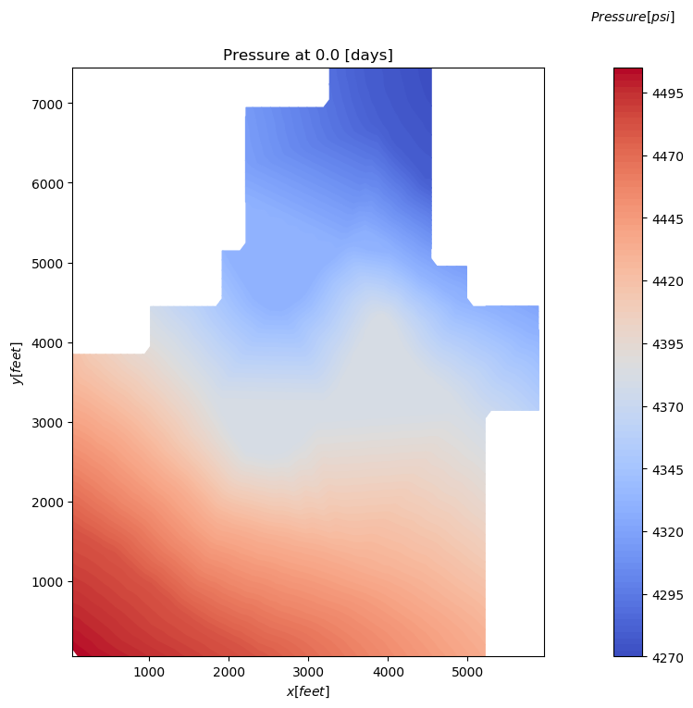
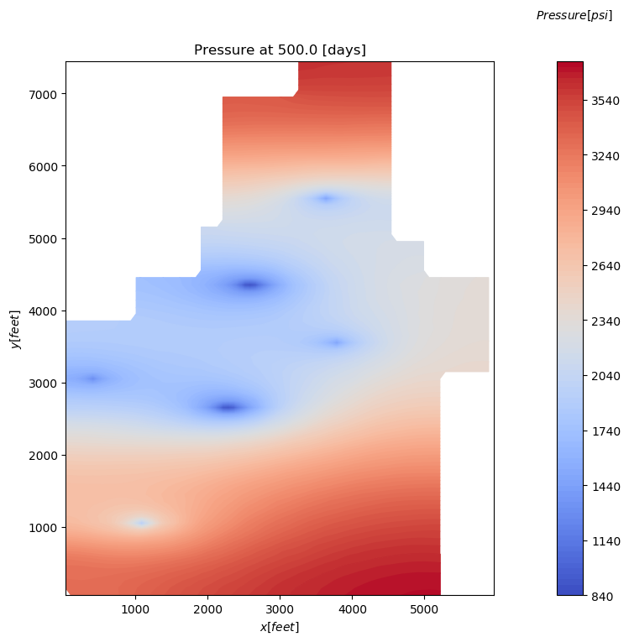
2.a Filled contour plot of reservoir OIL pressure at (i) initial (ii)500 days, (iii) 750 days, and (iv) 1000 days. Include a color bar (s) (with pressures labeled) and use appropriate range of pressures. Reservoir geometry should be obvious from your plots; use NaN for pressure outside of the reservoir boundaries.
(i) initial
(ii)500 days

Slide 4
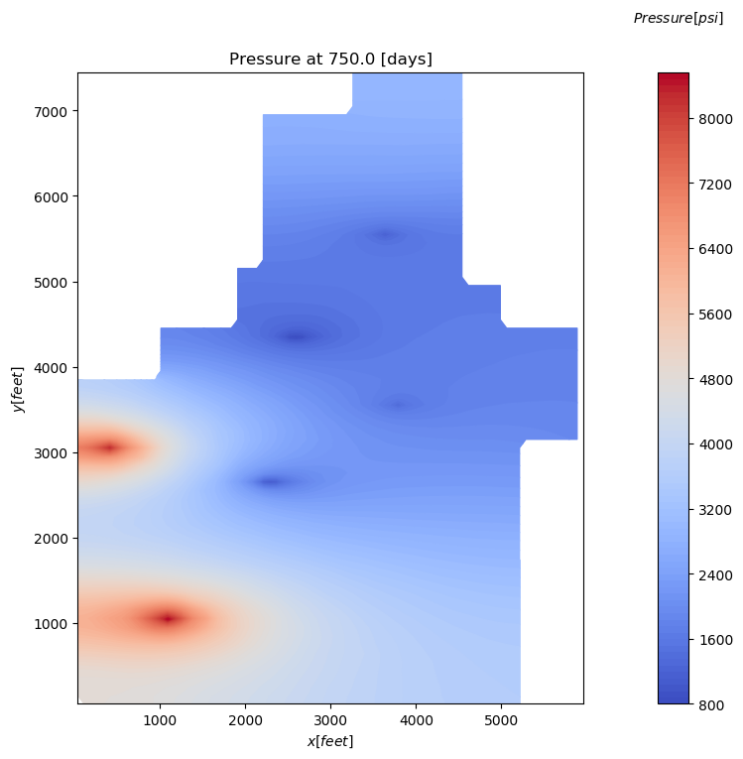
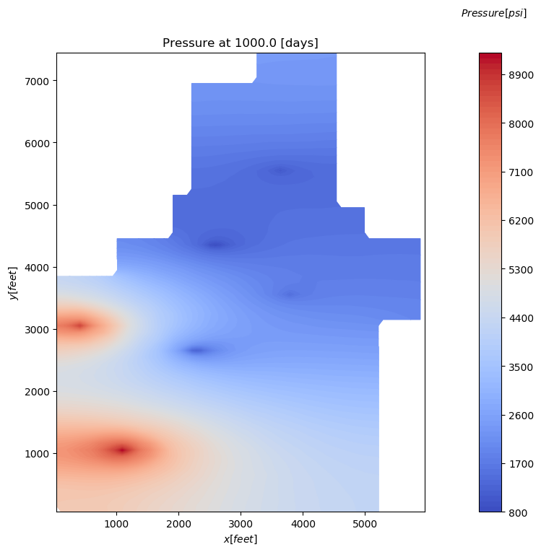
2.a Filled contour plot of reservoir OIL pressure at (i) initial (ii)500 days, (iii) 750 days, and (iv) 1000 days. Include a color bar (s) (with pressures labeled) and use appropriate range of pressures. Reservoir geometry should be obvious from your plots; use NaN for pressure outside of the reservoir boundaries.
(iii) 750 days
(iv) 1000 days

Slide 5
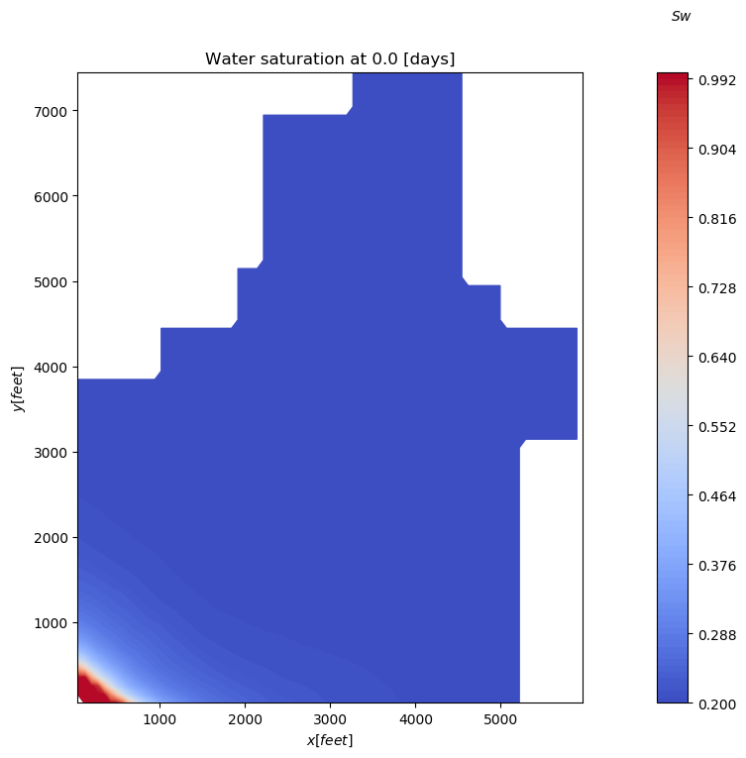

2.b Filled contour plot of reservoir Sw at (i) initial (ii)500 days, (iii) 750 days, and (iv) 1000 days. Include a color bar (s) (with pressures labeled) and use appropriate range of pressures. Reservoir geometry should be obvious from your plots; use NaN for pressure outside of the reservoir boundaries.
(i) initial
(ii)500 days

Slide 6

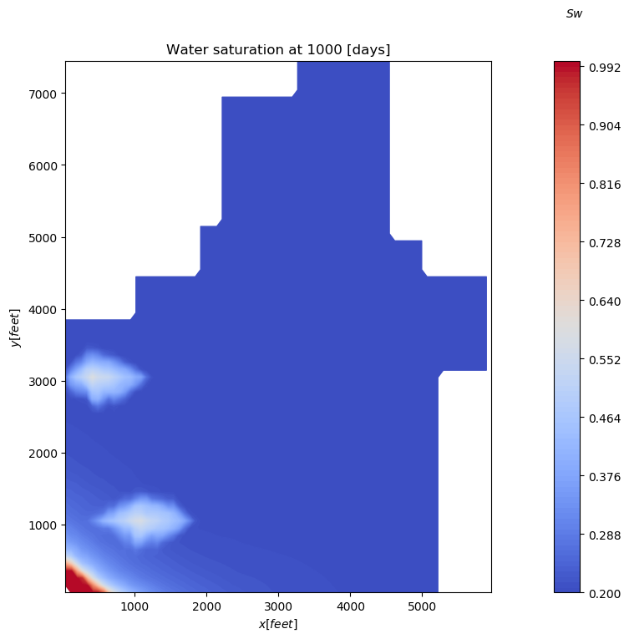
2.b Filled contour plot of reservoir Sw at (i) initial (ii)500 days, (iii) 750 days, and (iv) 1000 days. Include a color bar (s) (with pressures labeled) and use appropriate range of pressures. Reservoir geometry should be obvious from your plots; use NaN for pressure outside of the reservoir boundaries.
(iii) 750 days
(iv) 1000 days

Slide 7
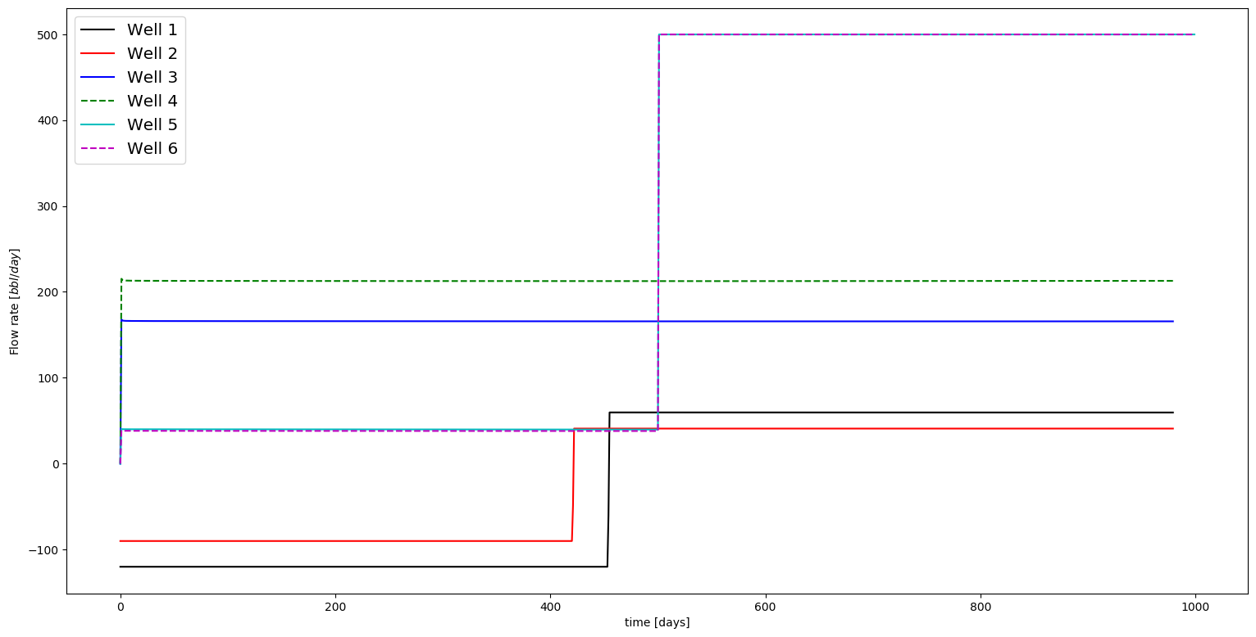
2.c Well flow rate (bbl/day) versus time (days) for all 6 wells (include a legend). Both axis should be linear. Time scale should be 0 to ~1000 days.

Slide 8
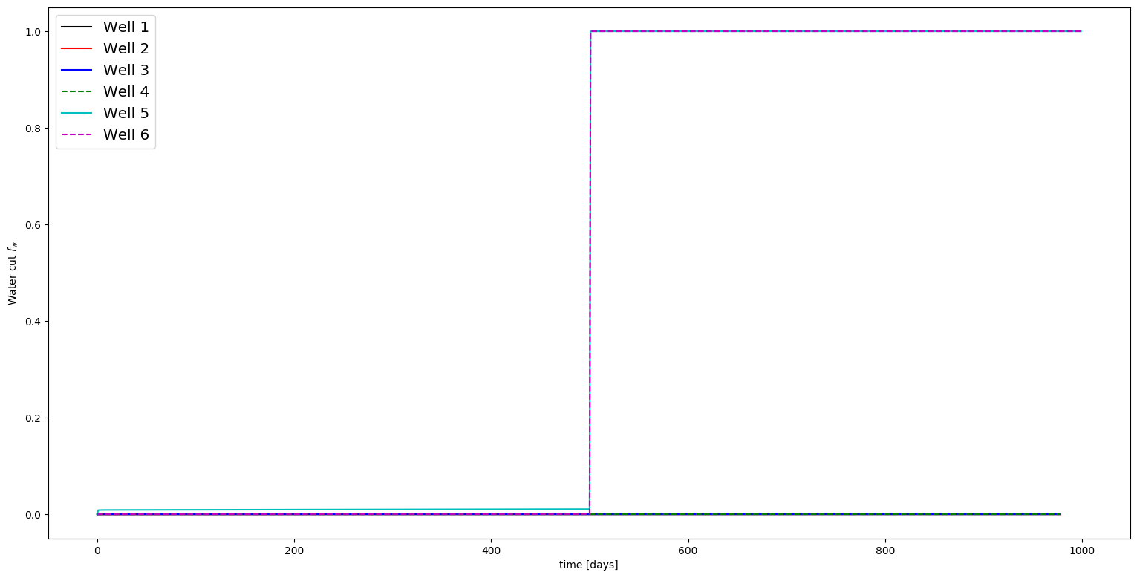
2.d . Well water cut (%) at standard conditions versus time (days) for all 6 wells (include a legend). Both axis should be linear. Time scale should be 0 to ~1000 days and 0 to 100%.

Slide 9
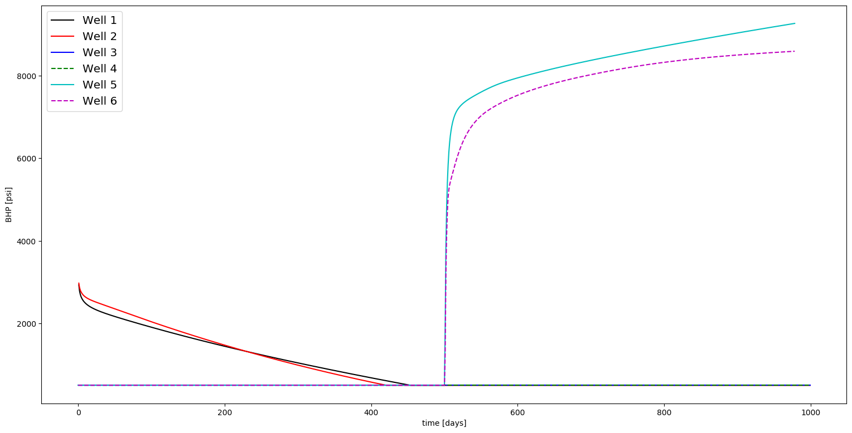
2.e . Well bottomhole pressure (psi) versus time (days) for all 6 wells (include a legend). Both axis should be linear. Time scale should be 0 to ~1000 days.

Slide 10
Table 1. Complete the following table
Well # |  | Your Solution | CMG
1 | Block # | 49 36 1 | 49 36 1
 | Initial Po | 4320.94
 | Initial Sw | 0.20055
 | Po at 500 days | 1434.46
 | Sw at 500 days | 0.20295
 | t when BHP=502.505 psi | 454
 | Po at 1000 days | 1034.99
 | Sw at 1000 days | 0.20320
 | Q at 1000 days (bbl/day) | 59.63
2 | Block # | 51 36 1 | 51 36 1
 | Initial Po | 4380.57
 | Initial Sw | 0.20121
 | Po at 500 days | 1450.62
 | Sw at 500 days | 0.20375
 | t when BHP=502.505 psi | 421
 | Po at 1000 days | 1442.31
 | Sw at 1000 days | 0.20363
 | Q at 1000 days (bbl/day) | 40.91
3 | Block # | 34:36 44 1 | 34:36 44 1
 | Initial Po | 4334.02, 4334.02, 4333.77
 | Initial Sw | 0.20064, 0.20064, 0.20064
 | Po at 500 days | 901.13, 856.40, 932.94
 | Sw at 500 days | 0.20324, 0.20326, 0.20309
 | Q at 500 days (bbl/day) | 165.69
 | Po at 1000 days | 889.92, 830.25, 882.29
 | Sw at 1000 days | 0.20323, 0.20326, 0.20311
 | Q at 1000 days (bbl/day) | 165.69

Slide 11
Table 1. Complete the following table
Well # |  | Your Solution | CMG
4 | Block # | 30:32 27 1 | 30:32 27 1
 | Initial Po | 4381.07, 4380.57, 4380.57
 | Initial Sw | 0.20123, 0.20123, 0.20123
 | Po at 500 days | 900.03, 871.68, 950.18
 | Sw at 500 days | 0.20383, 0.20391, 0.20379
 | Q at 500 days (bbl/day) | 212.47
 | Po at 1000 days | 1294.76, 1181.70, 1262.50
 | Sw at 1000 days | 0.20341, 0.20361, 0.20348
 | Q at 1000 days (bbl/day) | 212.83
5 | Block # | 15 11 1 | 15 11 1
 | Initial Po | 4475.46
 | Initial Sw | 0.22182
 | Po at 500 days | 1894.72
 | Sw at 500 days | 0.22508
 | Q at 500 days (bbl/day) | 39.75
 | Po at 1000 days | 9265.76
 | Sw at 1000 days | 0.57770
 | BHP at 1000 days | 9265.3
6 | Block # | 6 31 1 | 6 31 1
 | Initial Po | 4431.66
 | Initial Sw | 0.20352
 | Po at 500 days | 1277.00
 | Sw at 500 days | 0.20591
 | Q at 500 days (bbl/day) | 38.08
 | Po at 1000 days | 8590.08
 | Sw at 1000 days | 0.58660
 | BHP at 1000 days | 8590.05

Slide 12
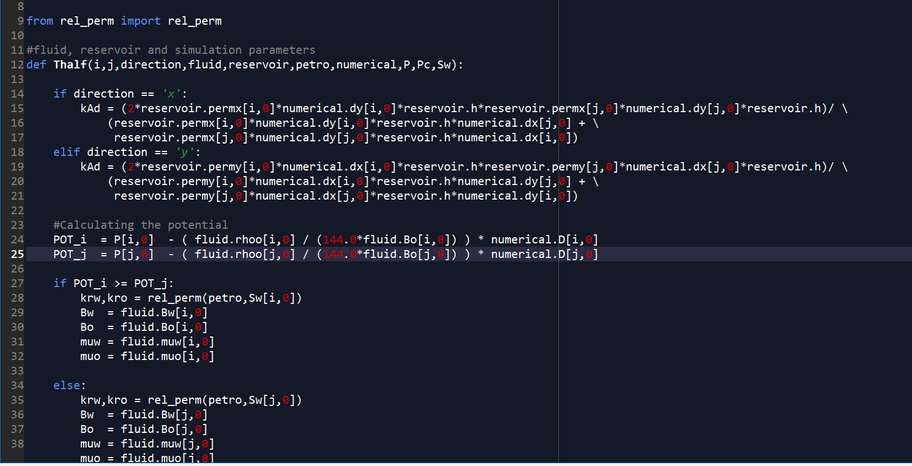
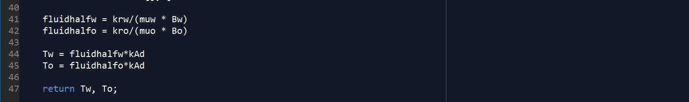
2.g Provide screenshot(s) of the function file (or portion of the code) that computes interblock transmissibility including UPWINDING. I just need to see enough information to know how you completed this task
Thalf

Slide 13
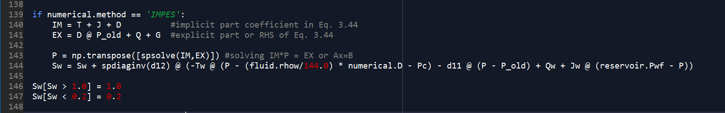
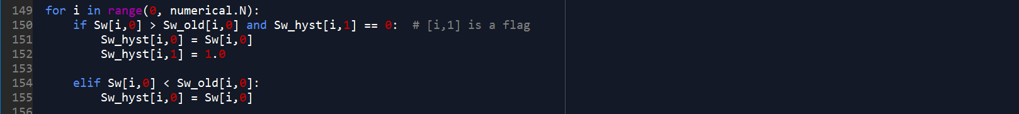
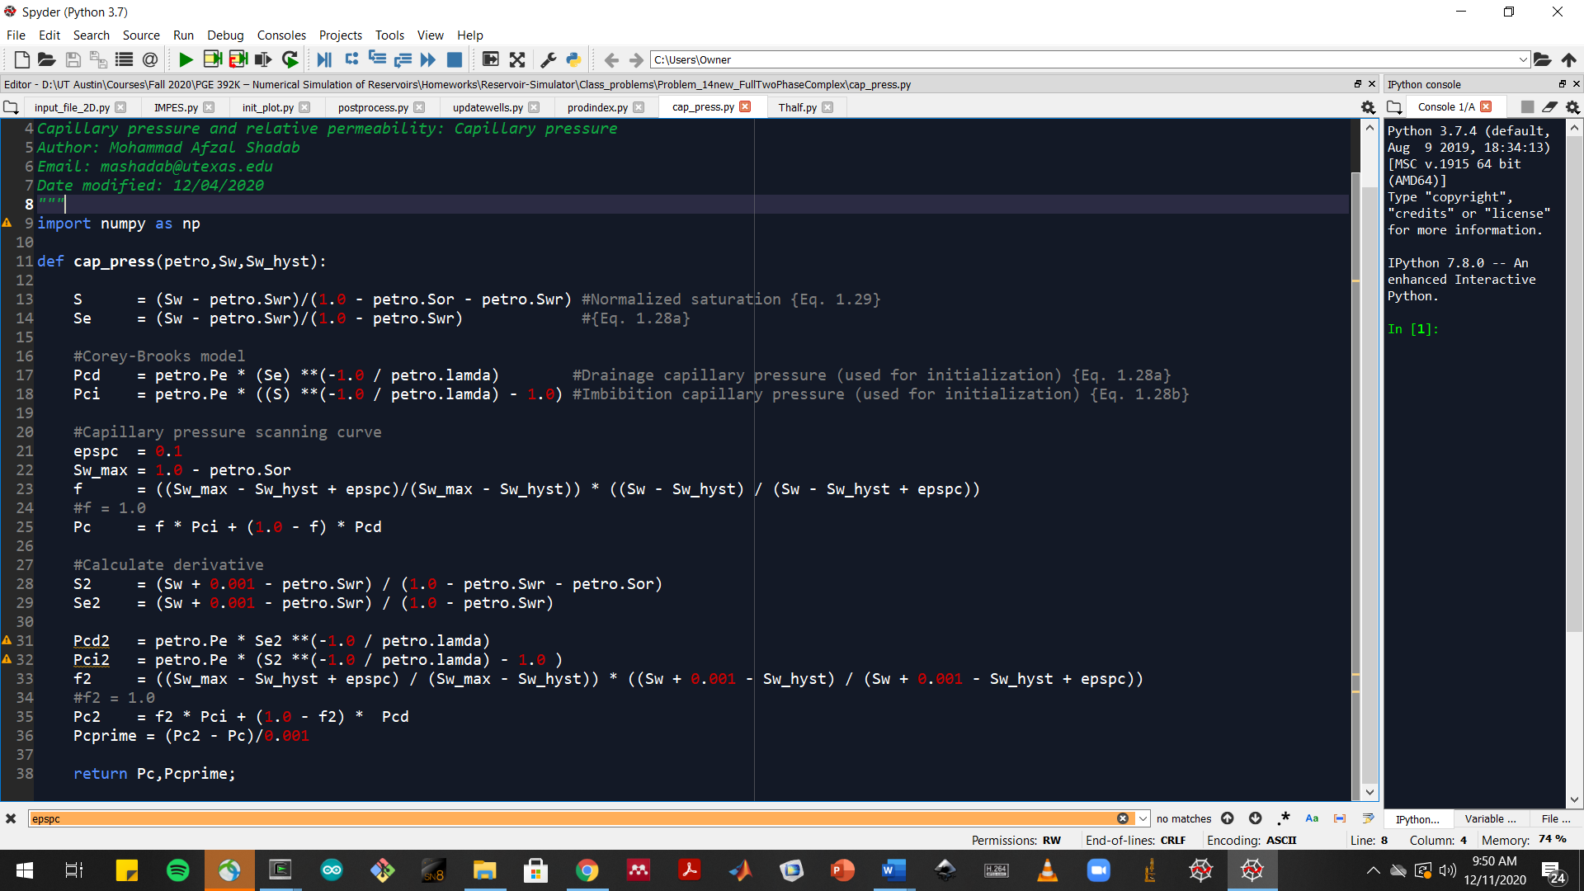
2.h Provide screenshot(s) of the the function file (or portion of the code) that shows how gravity and capillary pressure (imbibition) are included in the code
Gravity
(main code)
Sw_hyst
(main code)
Capillary
pressure
(cap_press
function)

Slide 14
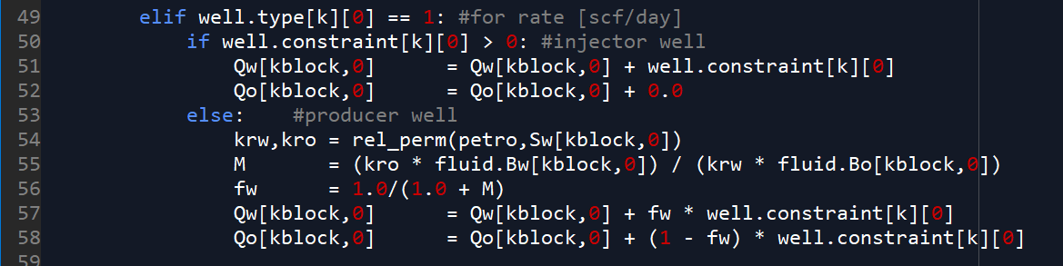
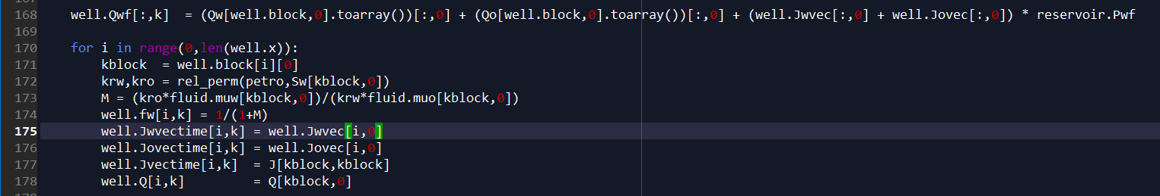
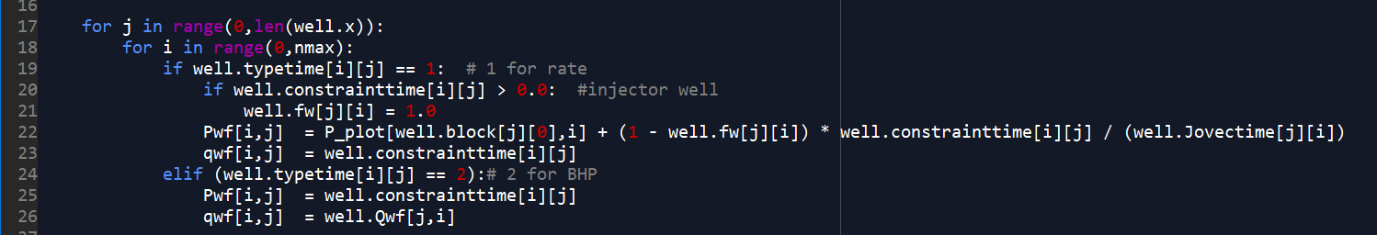
2.i Provide screenshot(s) of the the function file (or portion of the code) that computes the water and oil rates (e.g. water cut) in the code.
Water & oil rates
(updatewell function)
Total flow rate (Qwf) &
Water cut
(main function)
Water cut update & BHP evaluation for constant rate injectors
(postprocess function)

